Slide 1
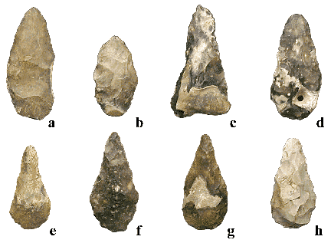
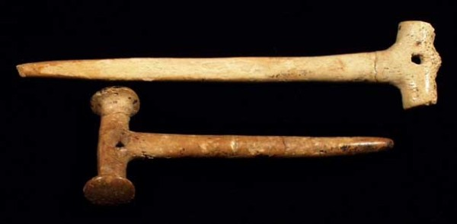
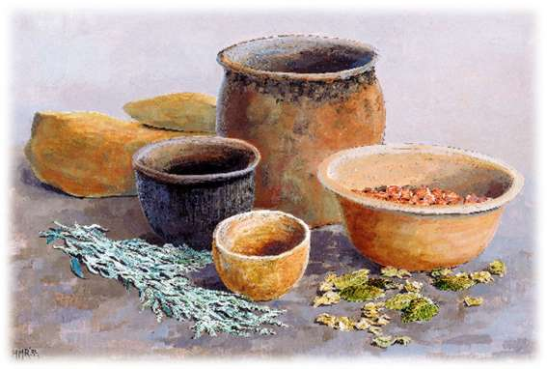
Paleolithic v/s Neolithic
Prehistory Timeline
What about these??

Slide 2
Please Create and Complete This Chart in Your Notebook
Factors of: | Paleolithic | Neolithic
Definition
Housing
Food/Living
Technology
Social Organization

Slide 3
Definitions:
Paleolithic (Old Stone Age) The first age in which people lived (c 2.3 million years ago – c.8,000 bc) when they mostly hunted and gathered their food.
Early Man Video Clip

Slide 4
Neolithic (New Stone Age) The time period starting c. 8,000 bc when humans started to settle into farming villages and started producing their own food.

Slide 5
4 factors used to tell them apart:
Housing
Means of Living (How they gather food)
Technology
Social Organization

Slide 6
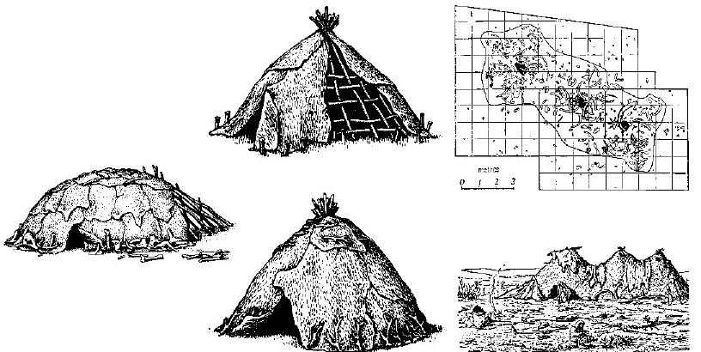
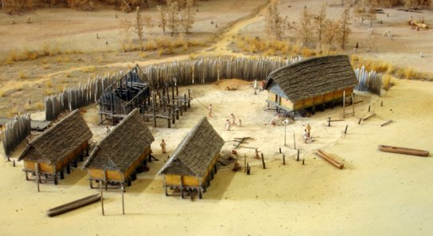
Housing
A House From Jarmo
Paleolithic:
Campsites, Tents, Caves and Huts
Temporary and Mobile
Neolithic:
Houses constructed of stone, mud, or wood.
More permanent

Slide 7
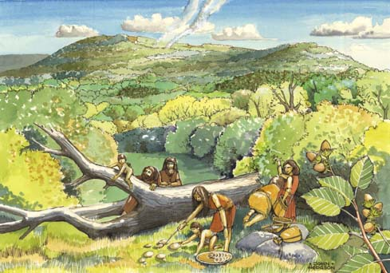
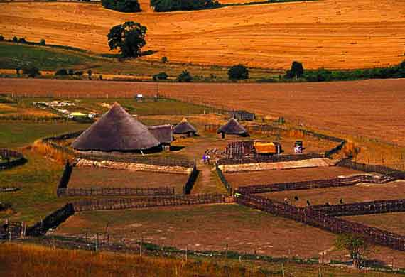
Means of Living (How they get food)
Paleolithic:
Hunting and gathering
Nomadic (moved with the food)
Neolithic:
Farming and herding
Start of specialized workers

Slide 8
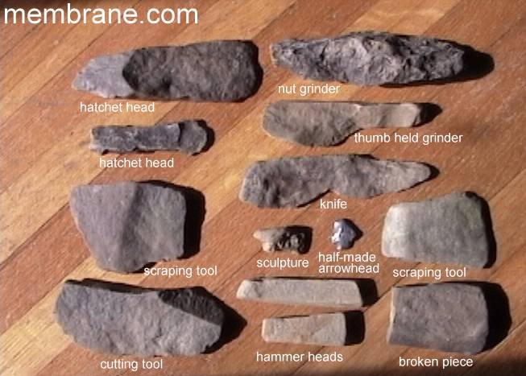
Stone Age Tool Interactive
Technology:
Paleolithic:
Hunting and gathering tools:
Baskets, skins, bone and stone tools
Neolithic:
Farming tools:
Pottery, metal work, spinning/weaving, etc

Slide 9
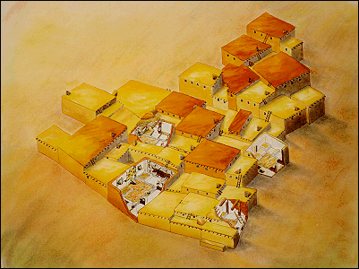
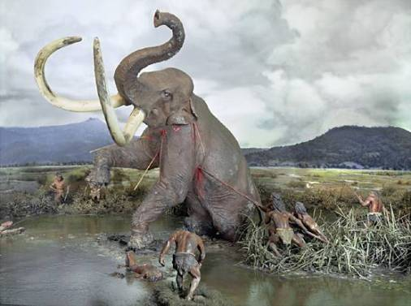
Social organization
Paleolithic:
Small Nomadic groups (25-40)
Society of equals, sharing resources
Neolithic:
Villages and small cities.
Private property

Slide 10
Now that you see the difference between both the Paleolithic peoples and the Neolithic peoples lets do and overview of how these groups developed to become a civilization that encompasses the five traits we discussed earlier.
Farmers/Herders domesticate plants and animals and settle in one area.
Paleolithic hunters and gathers

Slide 11
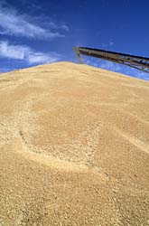
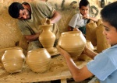
Specialized workers arise because people have enough food to start doing other types of work
Farmers produce a Surplus of Food and the population rises

Slide 12
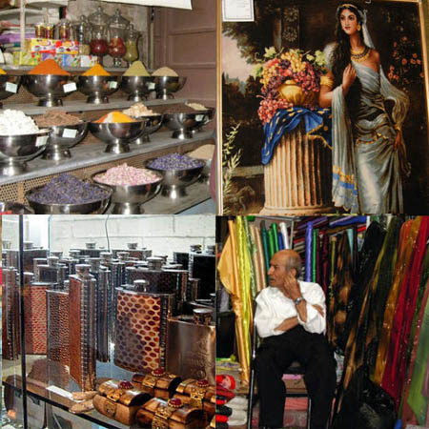
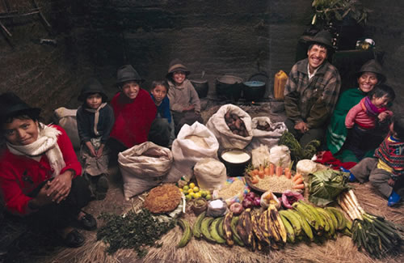
People start to produce more of everything and want items that they don’t make themselves
Trade develops

Slide 13
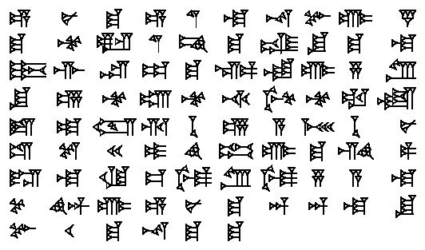
Writing develops to record trade transactions
Exchange of ideas and culture. Civilizations start to borrow and exchange ideas… civilizations grow and adapt.

Slide 14
Flowchart the growth of civilizations it should look similar to:
Paleolithic Hunt/Gather → Neolithic Farm/Herd
Do Hunters/Gatherers still exist?
Exchange of Ideas and Culture
Domesticate plants/animals
Writing – Recording Trade
Settle in one area
QUIA GAME - PALEOLITHIC OR NEOLITHIC?
Development of Trade
Surplus Food
Excess Production
Desire for Other Goods
Population Increase
Specialized Workforce

Slide 15
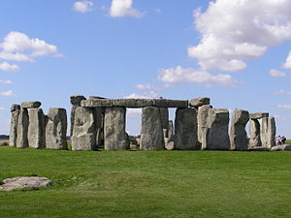
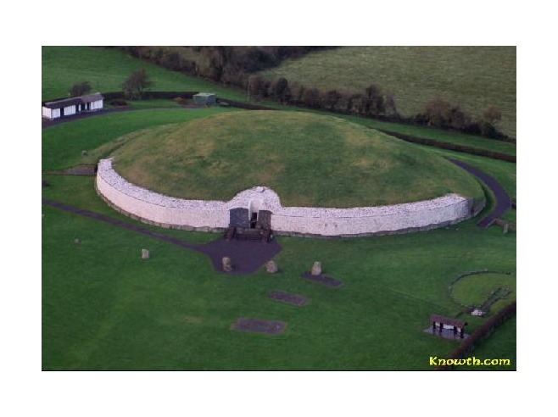
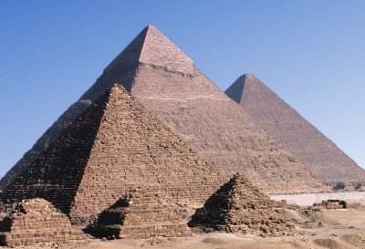
Great Neolithic Stone Monuments
Which of these ancient monuments was built first?
Stonehenge in England
(3000 B.C. to 1600 B.C.)
Newgrange tomb in Ireland
(3200 B.C.)
Pyramids of Egypt
(2575 B.C. to 2465 B.C.)
Notes:
The answer is the Newgrange Tomb in Ireland. Remind students that B.C. dates are counted backward from 0, so 100 B.C. is “younger” historically than 1000 B.C.

Slide 16
Please Create and Complete This Chart in Your Notebook
Factors of: | Paleolithic | Neolithic
Definition | The first age in which people lived (c 2.3 million years ago – c.8,000 bc) when they mostly hunted and gathered their food. | The time period starting c. 8,000 bc when humans started to settle into farming villages and started producing their own food.
Housing | Campsites, Tents, Caves and Huts Temporary and Mobile | Houses constructed of stone, mud, or wood. More permanent
Food/Living | Hunting and gathering Nomadic (moved with the food) | Farming and herding Start of specialized workers
Technology | Hunting and gathering tools: Baskets, skins, bone and stone tools | Farming tools: Pottery, metal work, spinning/weaving, etc
Social Organization | Small Nomadic groups (25-40) Society of equals, sharing resources | Villages and small cities. Private property

Slide 17
Sites to Explore
Tour Lascaux Cave
Stone Age Cave Paintings from Lascaux France
Visit Chauvet Cave
The Iceman's Last Meal
Buffalo Eddy - Washington and Idaho
"We're Nomadic" from Flocabulary

